Slide 1
Analyzing the Impact of Car Features on Price and Profitability
By Deepak soni

Slide 2
Contents:
Project Description
Approach
Tech-Stack Used
Insights
Result

Slide 3
Project Description:
The automotive industry has been rapidly evolving over the past few decades, with a growing focus on fuel efficiency, environmental sustainability, and technological innovation. With increasing competition among manufacturers and a changing consumer landscape, it has become more important than ever to understand the factors that drive consumer demand for cars.
In recent years, there has been a growing trend towards electric and hybrid vehicles and increased interest in alternative fuel sources such as hydrogen and natural gas. At the same time, traditional gasoline-powered cars remain dominant in the market, with varying fuel types and grades available to consumers.
For the given dataset, as a Data Analyst, the client has asked How can a car manufacturer optimize pricing and product development decisions to maximize profitability while meeting consumer demand?
This problem could be approached by analyzing the relationship between a car's features, market category, and pricing, and identifying which features and categories are most popular among consumers and most profitable for the manufacturer. By using data analysis techniques such as regression analysis and market segmentation, the manufacturer could develop a pricing strategy that balances consumer demand with profitability, and identify which product features to focus on in future product development efforts. This could help the manufacturer improve its competitiveness in the market and increase its profitability over time.

Slide 4
Approach:
The given problem would require advanced Excel skills and knowledge of data analysis techniques such as regression analysis, pivot tables, sensitivity analysis, optimization, and time series analysis.
However, by answering these questions and building an interactive dashboard, a data analyst could provide valuable insights to a car manufacturer and help them optimize their pricing and product development decisions to maximize profitability while meeting consumer demand.

Slide 5
Tech-Stack Used:
Microsoft Excel 2021 - A spreadsheet editor software used mainly by professionals to enter data in table format, perform computations, plot graphs etc. Here Microsoft Excel is used to filter data and plot graphs to get insights about IMDB MOVIES analysis project.
Microsoft PowerPoint - Microsoft PowerPoint is a powerful presentation software that allows you to create clean and impactful slideshows.

Slide 6
Identify Missing Data and Deal with it Appropriately:
In provided data set the no. of observation was 11914 and no. of variable was 16. Here we use count blank function to identify the blank space in dataset . Formulas: count blank: countblank(column)
The no. of blanks finds in variables are : Engine Fuel Type(3 blanks), Engine HP(69 blanks), Engine Cylinders(30 blanks), Number of Doors(6 blanks).
The no. of missing data is less, that’s why I decided to delete the blank space from data set that are 102 rows and removed duplicate values that are 715 rows .
After that the no. of observation remains are 11097.

Slide 7
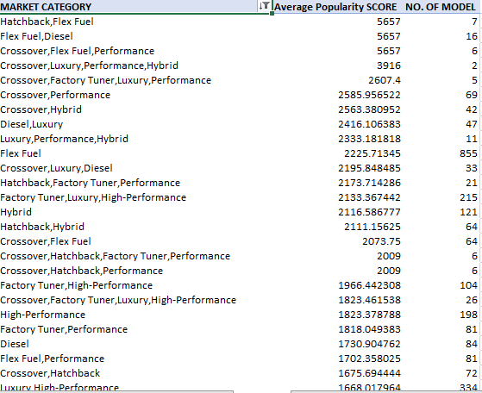
Data Analysis Task 1 A:
Task 1A : Create a pivot table that shows the number of car models in each market category and their corresponding popularity scores.
Result :

Slide 8
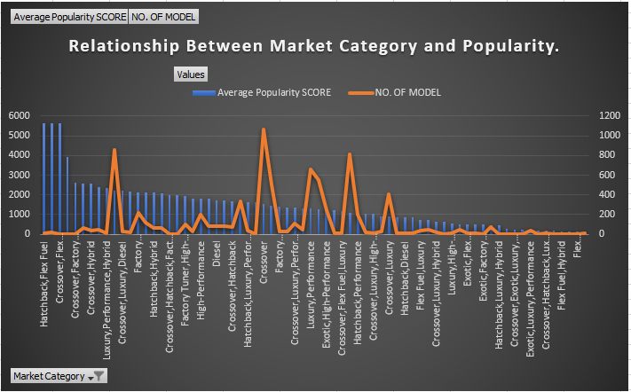
Data Analysis Task 1 B:
Task 1B : Create a combo chart that visualizes the relationship between market category and popularity.
Result :

Slide 9
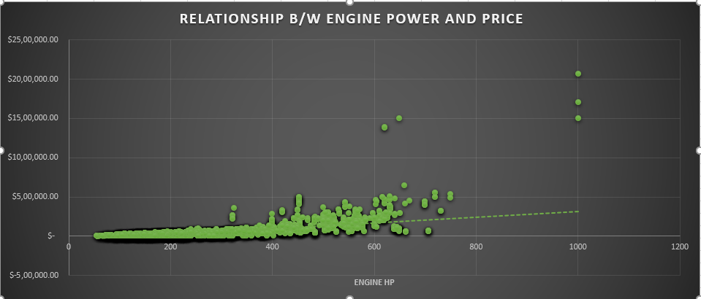
Data Analysis Task 2:
Task 2: Create a scatter chart that plots engine power on the x-axis and price on the y-axis. Add a trendline to the chart to visualize the relationship between these variables.
Result :

Slide 10
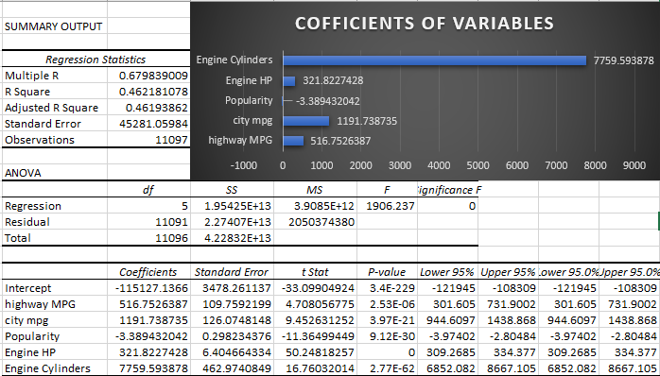
Data Analysis Task 3:
Task 3: Use regression analysis to identify the variables that have the strongest relationship with a car's price. Then create a bar chart that shows the coefficient values for each variable to visualize their relative importance
Result :

Slide 11
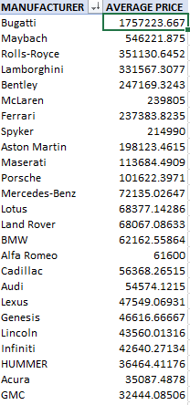
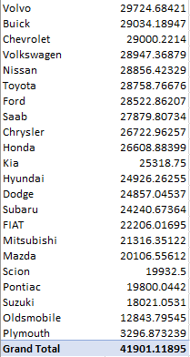
Data Analysis Task 4 A:
Task 4 A : Create a pivot table that shows the average price of cars for each manufacturer .
Result :

Slide 12
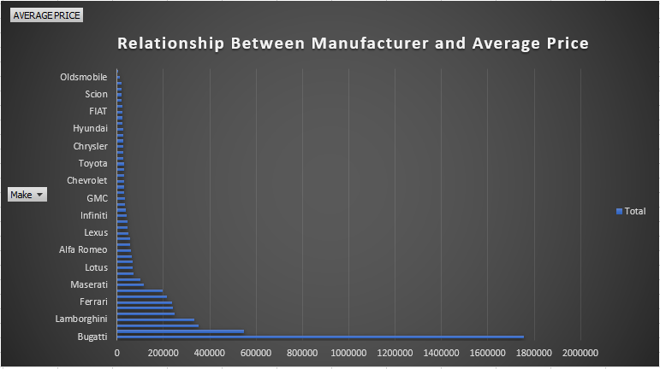
Data Analysis Task 4 B:
Task 4 B : Create a bar chart or a horizontal stacked bar chart that visualizes the relationship between manufacturer and average price.
Result :

Slide 13
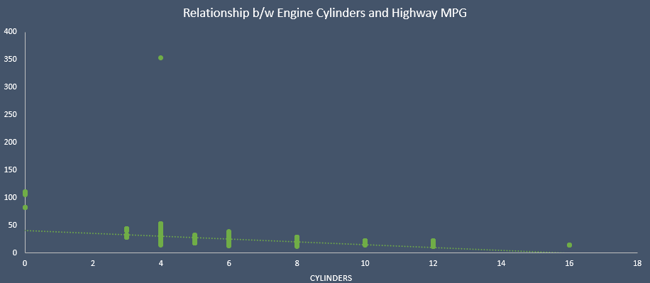
Data Analysis Task 5 A:
Task 5 A : Create a scatter plot with the number of cylinders on the x-axis and highway MPG on the y-axis. Then create a trendline on the scatter plot to visually estimate the slope of the relationship and assess its significance.
Result :

Slide 14
Data Analysis Task 5 B:
Task 5 B : Calculate the correlation coefficient between the number of cylinders and highway MPG to quantify the strength and direction of the relationship.
Result :

Slide 15
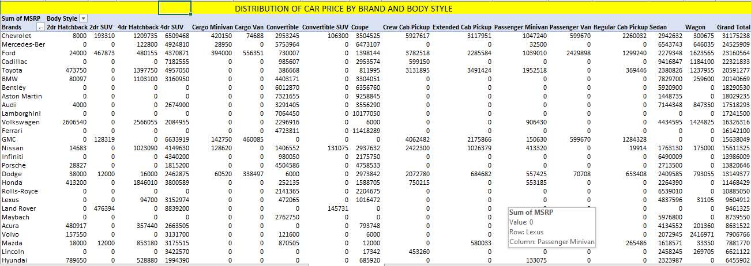
Dashboard Task 1:
Task 1: How does the distribution of car prices vary by brand and body style? Hints: Stacked column chart to show the distribution of car prices by brand and body style. Use filters and slicers to make the chart interactive. Calculate the total MSRP for each brand and body style using SUMIF or Pivot Tables. Results:

Slide 16
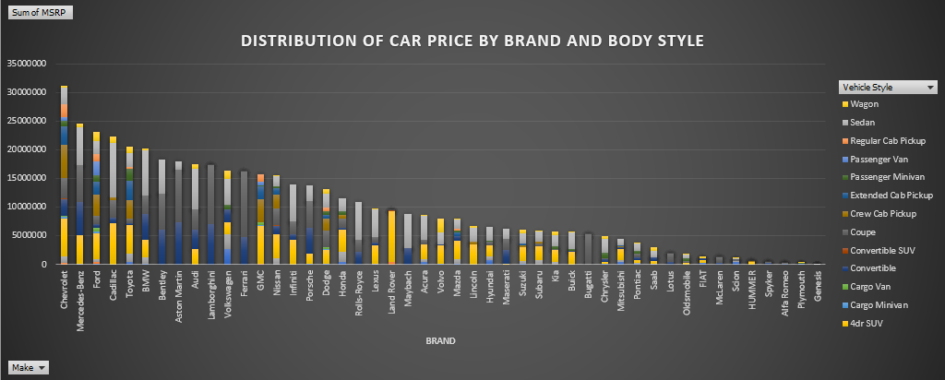
Dashboard Task 1:

Slide 17
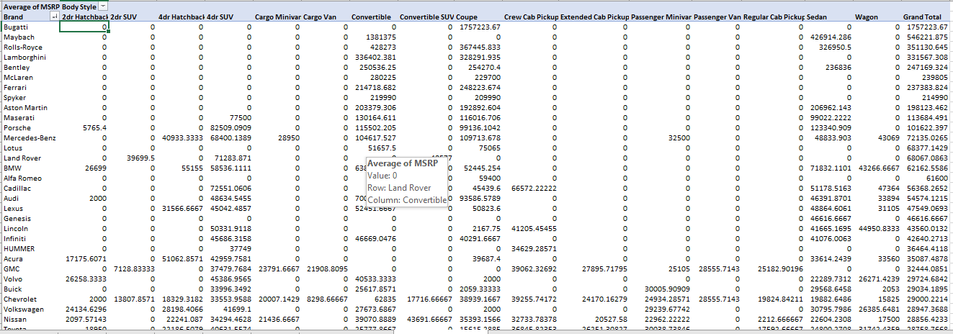
Dashboard Task 2 :
Task 2: Which car brands have the highest and lowest average MSRPs, and how does this vary by body style? Hints: Clustered column chart to compare the average MSRPs across different car brands and body styles. Calculate the average MSRP for each brand and body style using AVERAGEIF or Pivot Tables. Results :

Slide 18
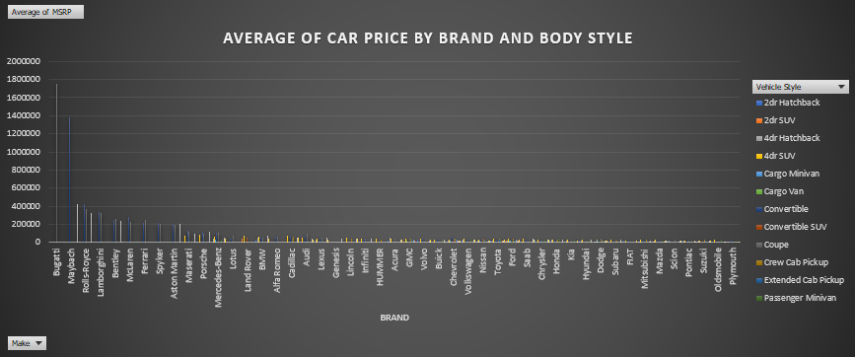
Dashboard Task 2:

Slide 19
Dashboard Task 3 :
Task 3: How do the different feature such as transmission type affect the MSRP, and how does this vary by body style? Hints: Scatter plot chart to visualize the relationship between MSRP and transmission type, with different symbols for each body style. Calculate the average MSRP for each combination of transmission type and body style using AVERAGEIFS or Pivot Tables. Results :

Slide 20
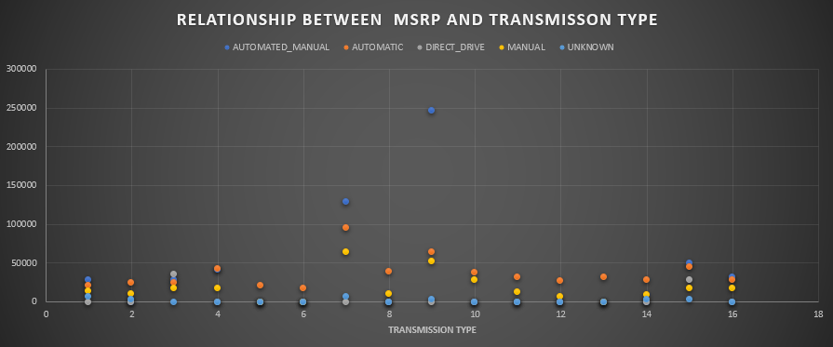
Dashboard Task 3 :

Slide 21
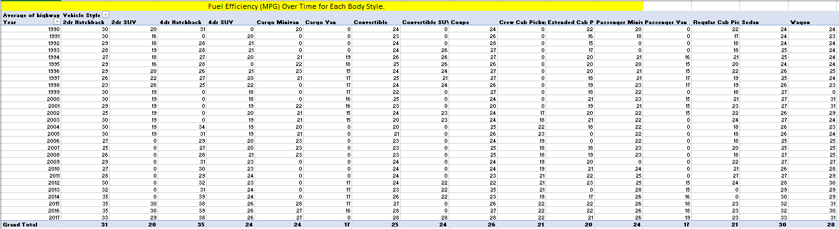
Dashboard Task 4 :
Task 4: How does the fuel efficiency of cars vary across different body styles and model years? Hints: Line chart to show the trend of fuel efficiency (MPG) over time for each body style. Calculate the average MPG for each combination of body style and model year using AVERAGEIFS or Pivot Tables. Results :

Slide 22
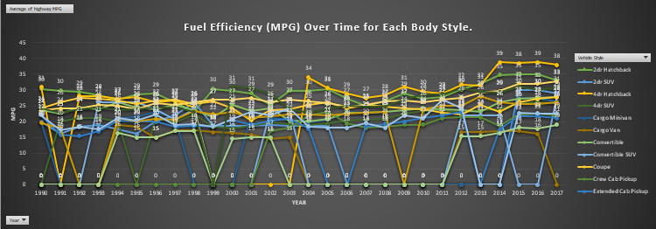
Dashboard Task 4 :

Slide 23
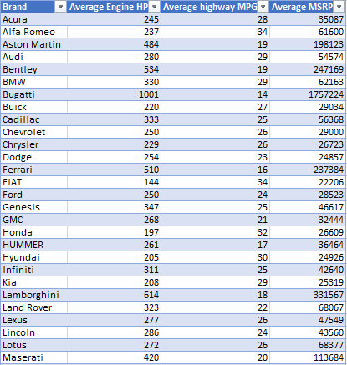
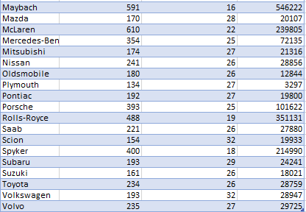
Dashboard Task 5 :
Task 5: How does the car's horsepower, MPG, and price vary across different Brands? Hints: Bubble chart to visualize the relationship between horsepower, MPG, and price across different car brands. Assign different colors to each brand and label the bubbles with the car model name. Calculate the average horsepower, MPG, and MSRP for each car brand using AVERAGEIFS or Pivot Tables. Results :

Slide 24
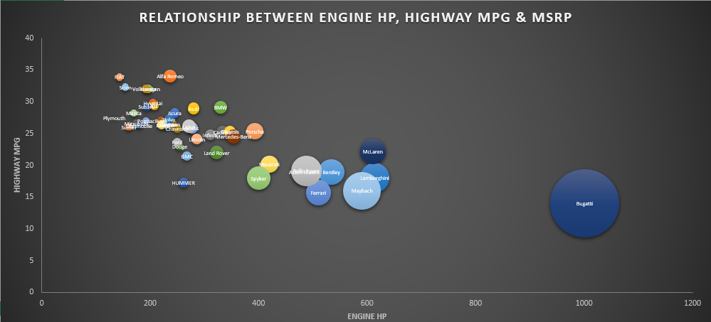
Dashboard Task 5 :

Slide 25
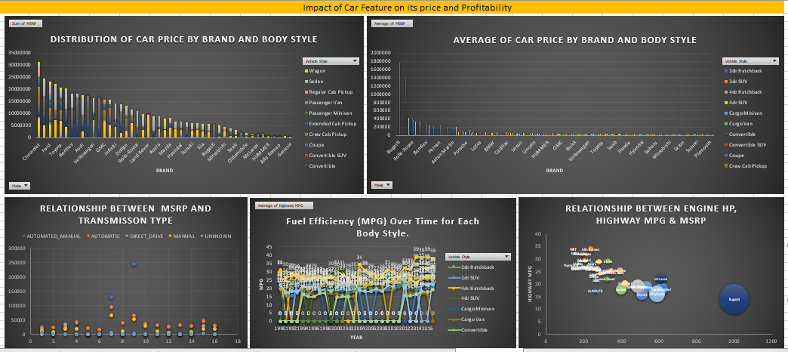
Dashboard View :

Slide 26
Insights:
The most popular category of car is Hatchback and Fuel Flex and have the highest number of cars as per the chart
Through the scatter plot we observe that cars with high engine power have higher prices.
Through Regression Analysis we conclude that engine cylinders have strongest relationship with MSRP and number of doors have the weakest relationship with MSRP.
From the bar chart it is clear that Bugatti and Maybach have the highest average price.
The scatter plot shows that no. of cylinders having 4 has the maximum fuel efficiency.
Body style of Chevrolet and Mercedes Benz have the highest contribution in car price.
Coupe style of Bugatti and Convertible style of Maybach have the highest average car price.
From the scatter plot it is observed that AUTOMATED_MANUAL with Coupe and Convertible vehicle style as well as AUTOMATIC with Coupe and Convertible vehicle styles are highest contributors of MSRP.
The line chart shows that as the years have passed fuel efficiency of cars have increased.
From the bubble chart we observe that higher the engine power, higher the price. Cars with low highway MPG have low prices.

Slide 27
Results:
The project has provided a comprehensive understanding of the Car features and its pricing. I learnt a lot about advanced excel charts and how to use them. This analysis can be used as an efficient and valuable tool for budgeting and also for the planning and designing of cars as per customer requirements. The insights derived in this project can be used in effective decision making for the stakeholders and the potential customers.

Slide 28
Thank y u

